Slide 1
CH2PH2:
Surfaces and Interfaces
Dr. James Hallett
j.e.hallett@reading.ac.uk

Slide 2
Strong module overlap with:
  CH2PRAC/X – relevant to 2 experiments in physical section
  CH2CS2 - the physical chemistry that underpins all formulations!
  And next year...
  CH3CC1, CH3CC2, CH3PRO, CH3PR1, CH3CS2, CH3PC2...

Slide 3
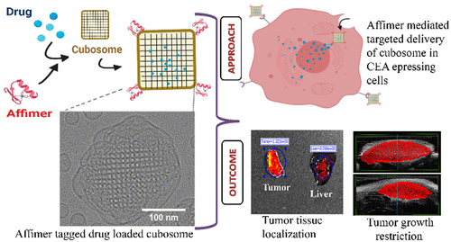
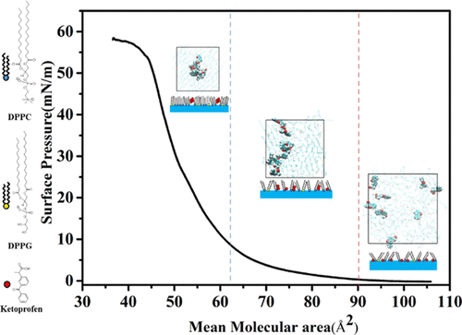
Relevant to research in:
  Pharmacology or medicinal chemistry – new ways of encapsulating drugs, understanding the "physical chemistry" of the interactions between cells membranes and drugs etc.
Hu, J., Liu, H., Xu, P., Shang, Y., & Liu, H. (2019). Investigation of drug for pulmonary administration–model pulmonary surfactant monolayer interactions using Langmuir–Blodgett monolayer and molecular dynamics simulation: a case study of Ketoprofen. Langmuir, 35(41), 13452-13460.
Pramanik, A., Xu, Z., Shamsuddin, S. H., Khaled, Y. S., Ingram, N., Maisey, T., ... & Millner, P. A. (2022). Affimer tagged cubosomes: Targeting of carcinoembryonic antigen expressing colorectal cancer cells using in vitro and in vivo models. ACS Applied Materials & Interfaces, 14(9), 11078-11091.

Slide 4
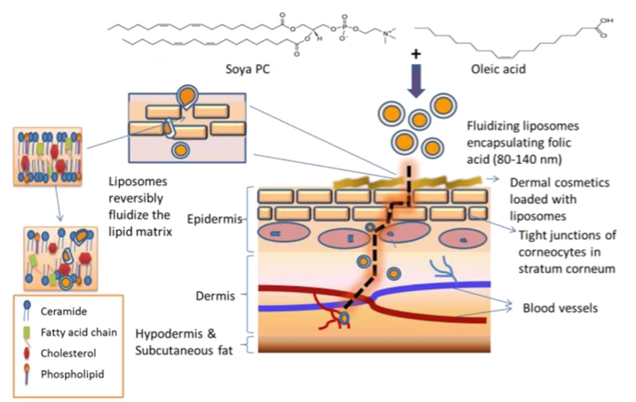
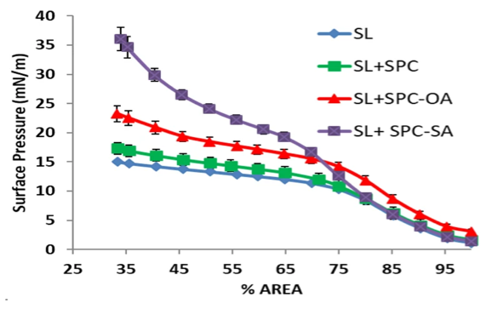
Relevant to research in:
  Cosmetic chemistry – designing new formulations that are more environmentally friendly, have new properties, better shelf life etc.
Kapoor, M. S., D’Souza, A., Aibani, N., Nair, S. S., Sandbhor, P., Kumari, D., & Banerjee, R. (2018). Stable Liposome in Cosmetic Platforms for Transdermal Folic acid delivery for fortification and treatment of micronutrient deficiencies. Scientific reports, 8(1), 16122.

Slide 5
Research (project) overlap with:
  If this series of lectures interests you, staff in the department with research in relevant areas include: James Hallett, James Cooper, Ian Hamley...

Slide 6
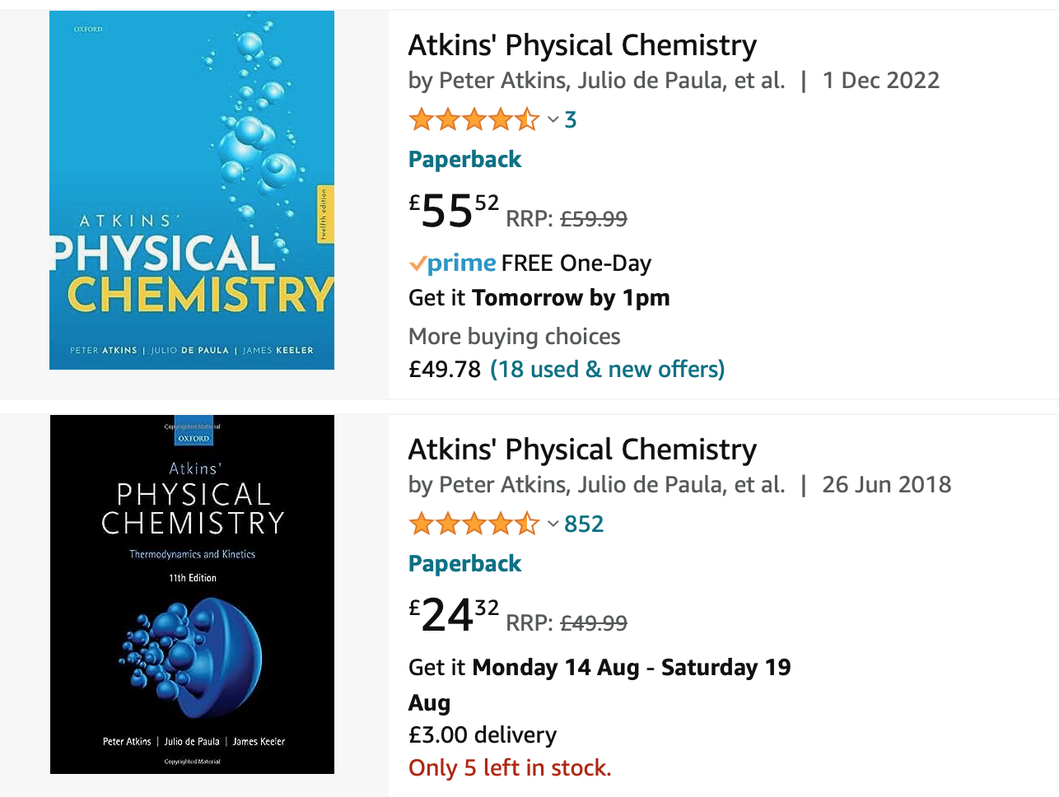
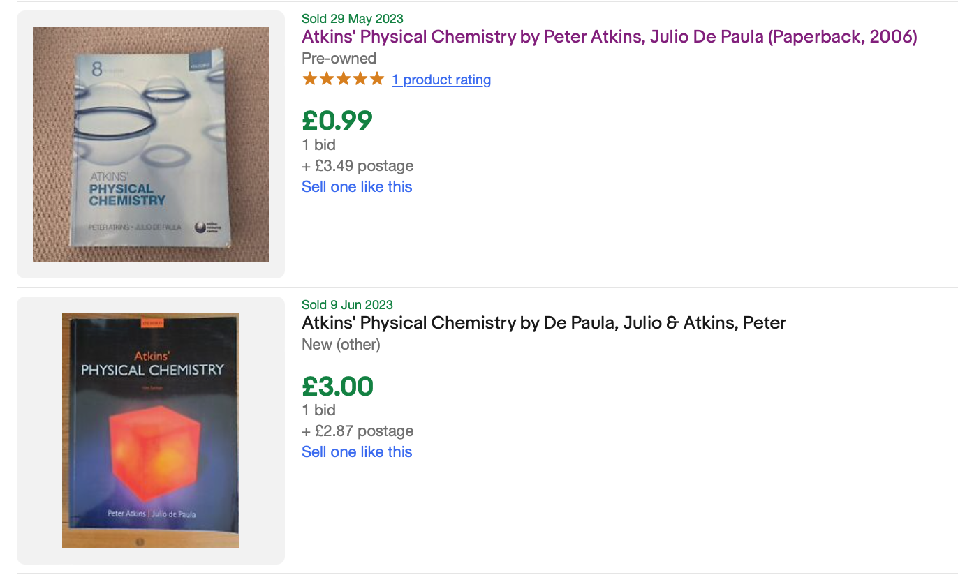
Recommended texts:
  As always, Atkins Physical Chemistry (12th edition)
  Get it out of the library, read it online (via the library), read it in G50.

Slide 7


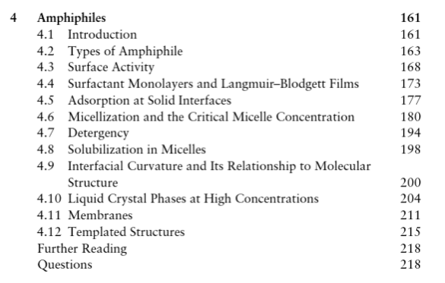
Recommended texts:

Slide 8
Outline:
Surface and interfacial tension
Surfactancy
Gibbs adsorption isotherms
Micellization and surface activity
Critical micelle concentration as equilibrium
Thermodynamics of micellization
Liquid crystal phases

Slide 9


Physical Chemistry of Surfaces
The physical chemistry of surfaces can be used to describe many phenomena:
The size and behaviour of liquid drops.
Water flow in plants.
The shapes of cell membranes and bubbles.
We will begin by examining the tendency of liquids to want to minimize their surfaces.
Let’s look at the work needed to change the surface area of a substance:
The surface area of the substance.
CAUTION: sometimes this is labelled dA
The work in this case is physical work and so is equal to the Helmholtz energy of the process. CAUTION: sometimes this is labelled F
Surface tension; how strongly a surface holds together.

Slide 10
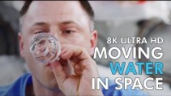
https://youtu.be/H_qPWZbxFl8?feature=shared

Slide 11
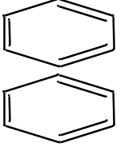
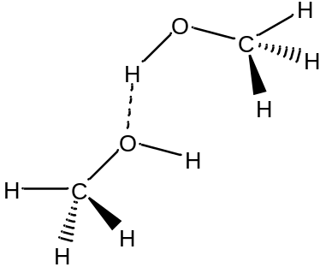
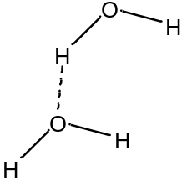
Surface tension
Surface tension depends strongly on intermolecular forces.
Stronger forces hold a surface together strongly, and vice versa.
p-stacking: an induction force that relies on polarizability.
 | γ (N/m)
C₆H₆ | 0.029
CH₃OH | 0.023
H₂O | 0.073
Hydrogen bonds, but with steric hindrance.
Hydrogen bonds: a dipole/dipole force.

Slide 12
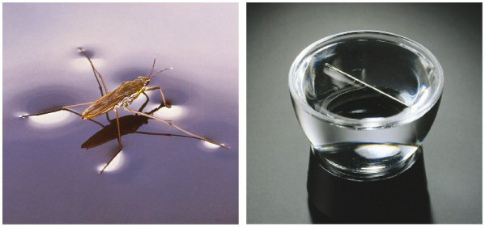
Surface tension

Slide 13




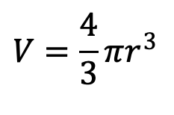
Surface tension and work
We would like to know the spontaneous direction of this surface work:
The surface tension is generally a positive number, so:
This implies that the spontaneous direction of surface work is for surface area to decrease.
Let us look more closely at surface area:
For a sphere, we have:
We are often interested in the surface to volume ratio (s/V): this tells how much of a substance is surface compared to how much is bulk.
$$V=\frac{4}{3}πr^{3}$$

Slide 14
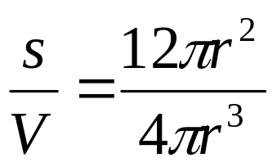
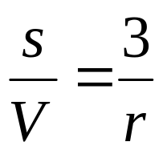
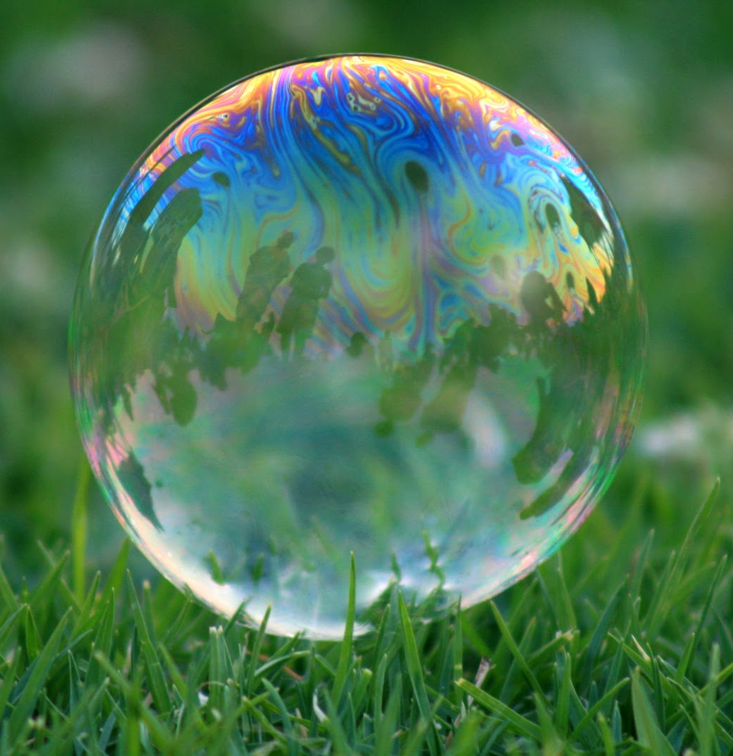
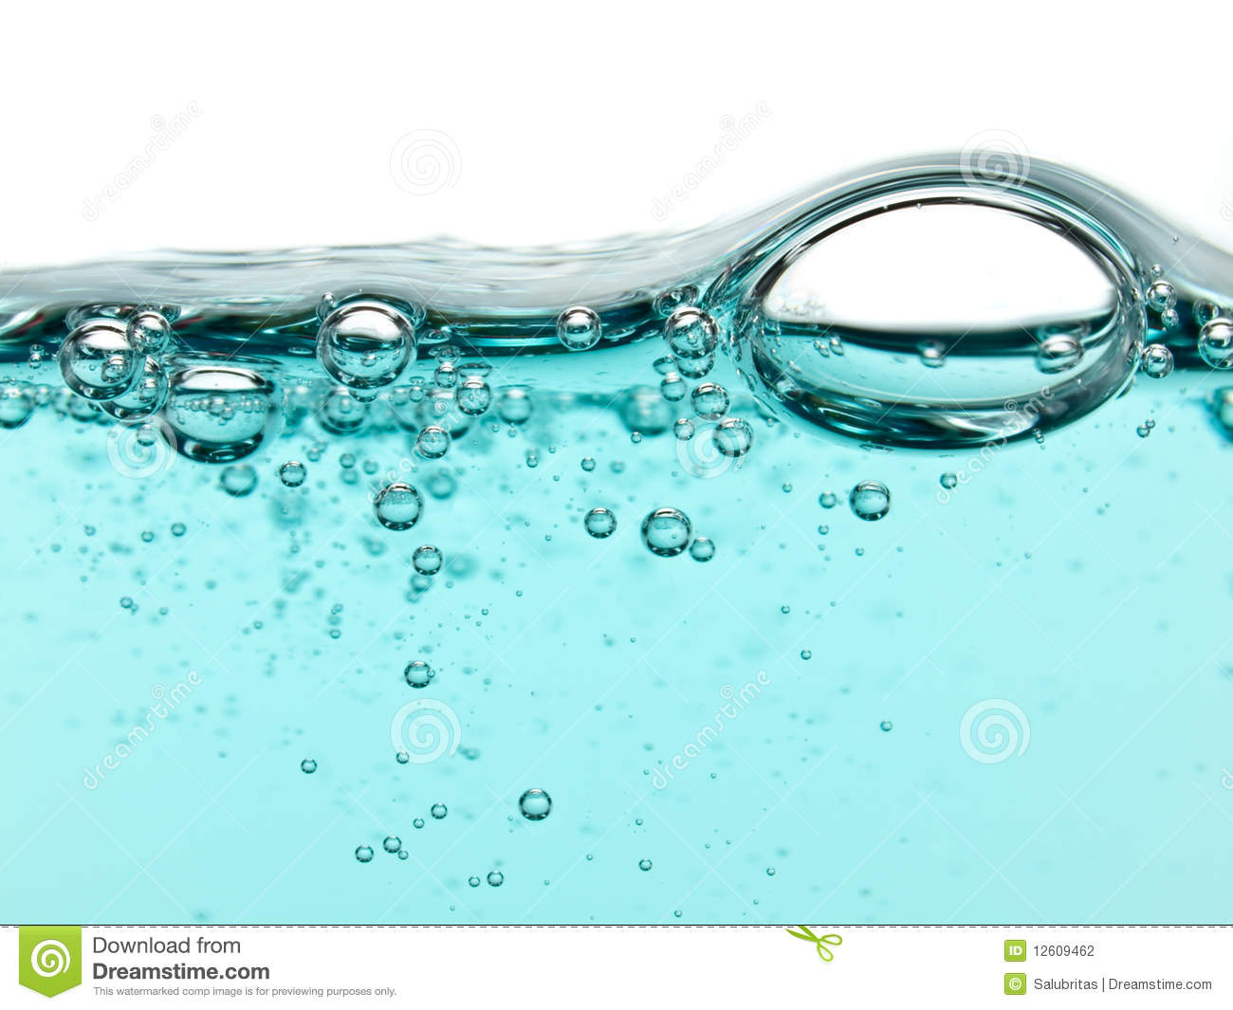
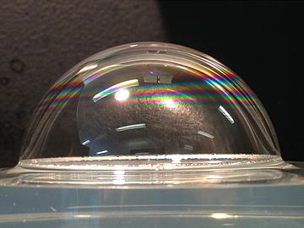
Bubble stability
For a sphere we get:
For a small radius, we get relatively more surface.
For a large radius, we get relatively less surface.
One type of process where we can look at surface work is bubble formation.

Slide 15
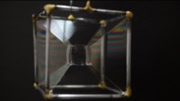
https://youtu.be/E_KH3FNtOIw
Notes:
https://youtu.be/E_KH3FNtOIw

Slide 16

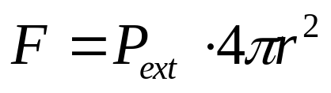
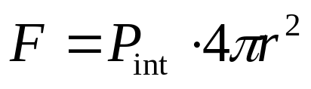

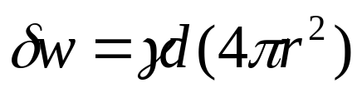
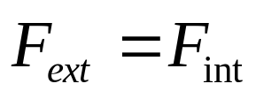

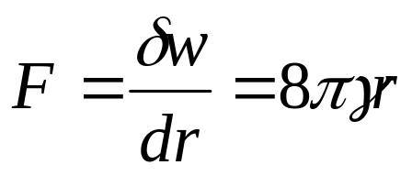
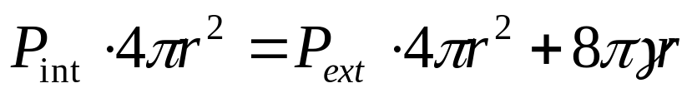
Bubble stability
What governs bubble stability and size?
We can balance the forces acting inside and outside the bubble:
External forces:
Internal forces:
From air pressure:
From air pressure:
From surface tension:
At equilibrium the internal and external forces will balance:

Slide 17
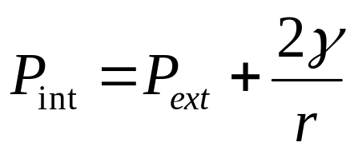
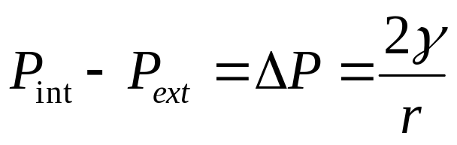
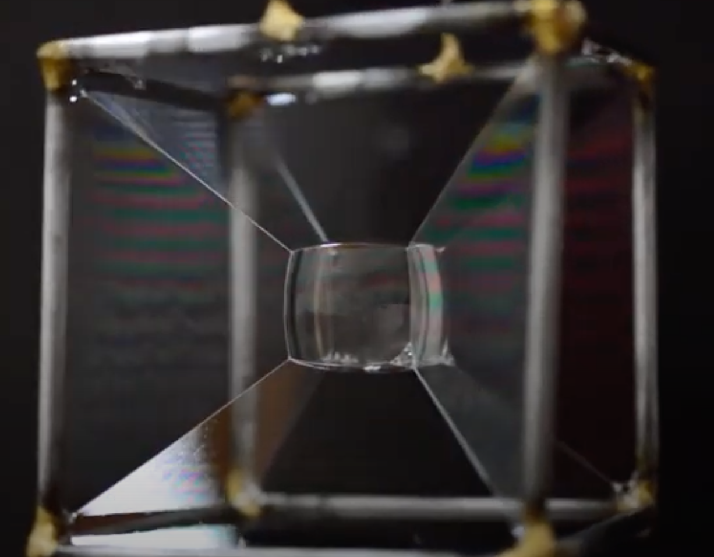
Laplace pressure
We can rearrange this expression:
A smaller pressure difference is most stable, thus this equation shows that bubbles favor large radii. This pressure difference is the Laplace pressure

Slide 18
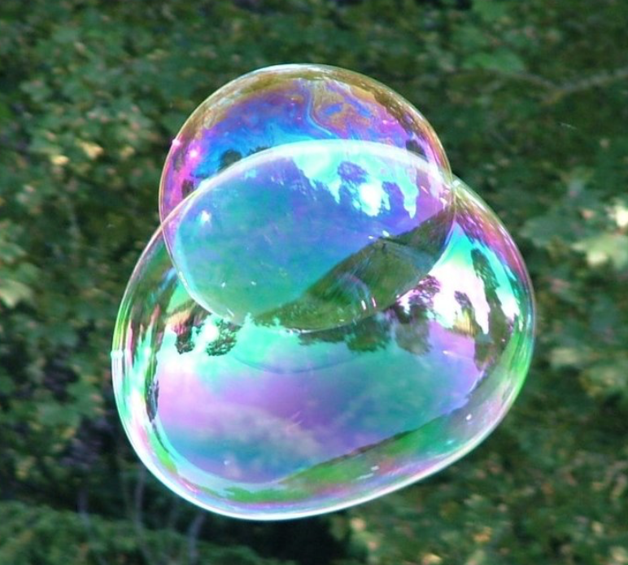
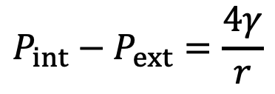
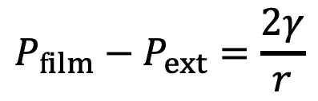
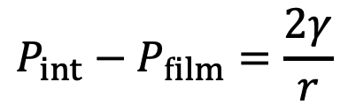
Laplace pressure
For a Cavity (e.g. gas in liquid)
For a Bubble (e.g. gas in thin liquid film in gas)
$$P_{int}−P_{film}=\frac{2γ}{r}$$
$$P_{film}−P_{ext}=\frac{2γ}{r}$$
$$P_{int}−P_{ext}=\frac{4γ}{r}$$

Slide 19
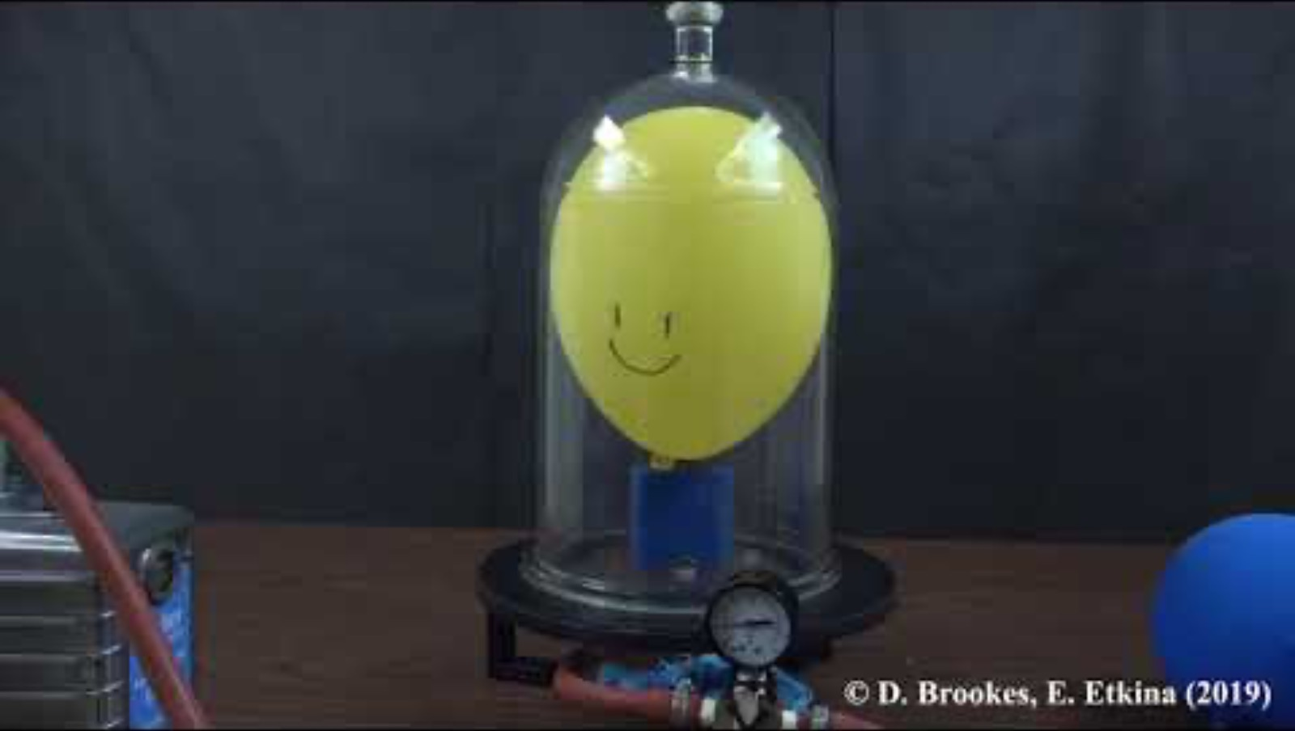
https://youtu.be/dESN-ndzwFc?si=Qw3jQp6LuJvR4bZ6

Slide 20
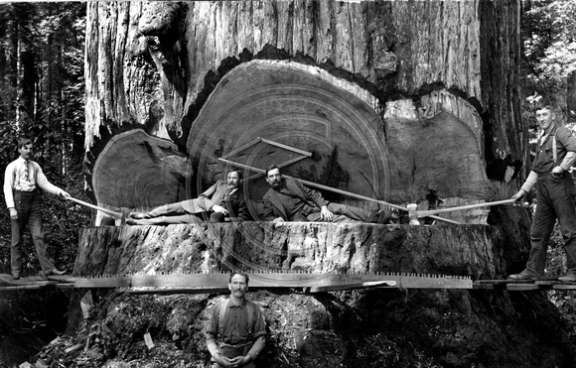
One more related question: how does water climb from the roots of a redwood to the top?
What are the vessels that take water up a plant?
We can examine these by considering a tube in liquid, like a straw in a soft drink.

Slide 21
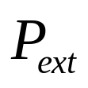
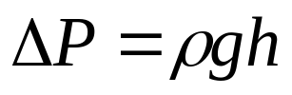
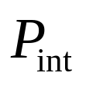
Capillary action
Capillary action
The extra pressure on the liquid inside the straw is equal to the hydrostatic pressure applied by the column of liquid that rises up.

Slide 22
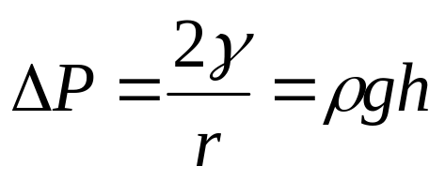
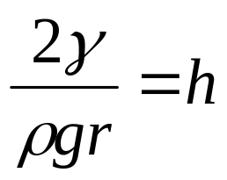
Capillary action
We can find the relationship between how high the liquid rises and the radius of the straw (or tube):
We can use this to examine the redwood.
The xylem has a radius of 2 x 10⁻⁵ m, so
If we use the surface tension and density of water, the height that capillary action can raise the water is 0.74 m.
Can capillary action take water to the top of a redwood?
What other mechanisms can be involved.
Key: water has a high tensile strength.
Why does water have a high tensile strength?

Slide 23
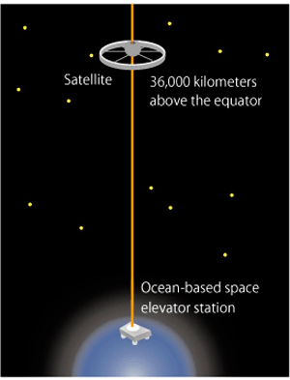
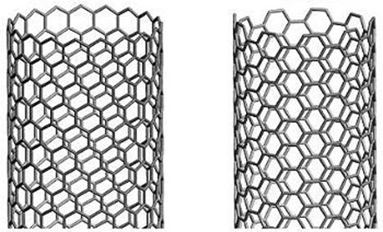
Physical Chemistry of Surfaces
Carbon nanotubes.

Slide 24
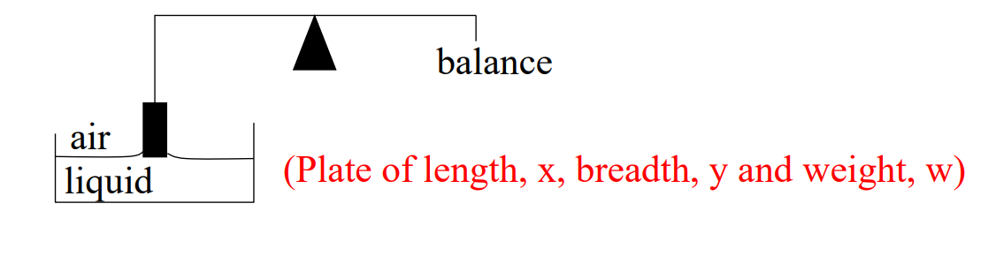
Measuring surface tension
How to measure surface tension:
Wilhelmy plate – thin platinum plate/piece of filter paper is suspended from the arm of a balance and dipped into solution.
Displaced liquid will push the plate upwards (buoyancy)
Detachment method: Pull on the balance and note the point of detachment. w_{det} – w = 2(x+y)𝛾
Static method: Keep the plate in contact with the liquid – the change in force required to maintain constant immersion is measured.

Slide 25
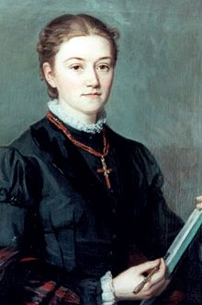
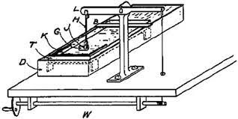
Agnes Pockels
Self-taught German chemist (1862-1935)
Became interested in surface tension through doing domestic chores
Invented her own instrument for measuring surface tension – a metal tray with a button connected to a balance
Used to determine the effect of surfactants on surface tension, and determine the molecule size (the “Pockel point”)
Contacted Lord Rayleigh (1904 Nobel prize winner) with her results – he helped publish them
First woman to receive an honorary doctorate

Slide 26
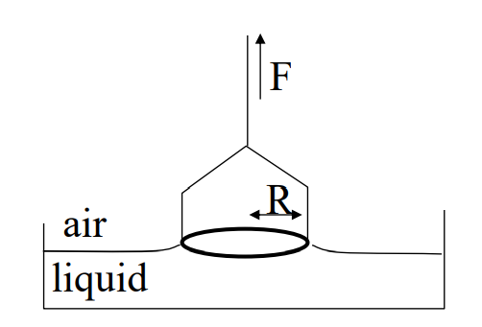
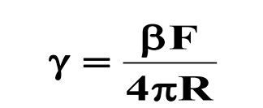
Measuring surface tension
Platinum ring method:
The force required to detach the ring from the surface is measure and is related to the surface tension by:
beta is a correction factor which allows for the non-vertical direction of the tension forces and for the complex shape of the liquid supported by the ring at point of detachment

Slide 27
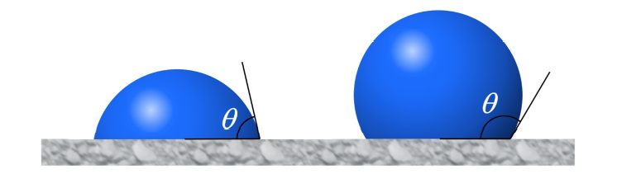
Wetting versus non-wetting
The contact angle is between the surface and the liquid/gas interface:
Contact angles depend on the chemical composition/intermolecular forces of/between the three phases involved.
The limiting case is θ = 0° when the liquid spreads over the solid surface.
The cases of θ > 0° are divided, by convention, into wetting and non-wetting conditions

Slide 28
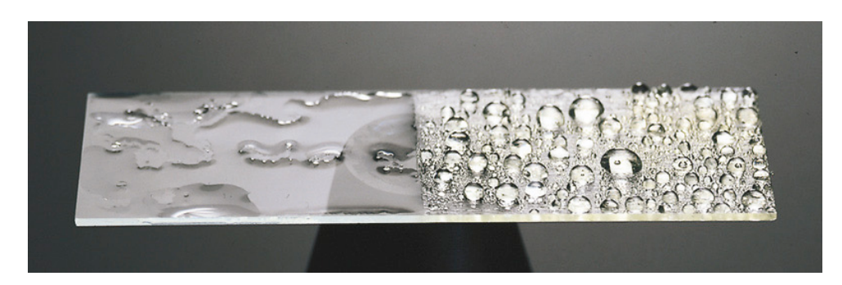
Wetting versus non-wetting
Wetting:
0 < θ < 90
Non-wetting:
90 < θ < 180
How do we get this?

Slide 29
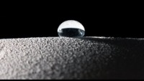
https://youtu.be/SIiv-hkRvZE
Notes:
https://youtu.be/SIiv-hkRvZE

Slide 30
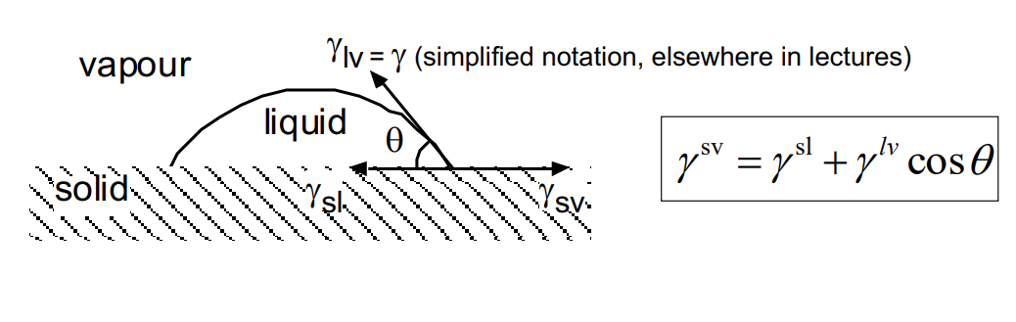
Wetting versus non-wetting
Interfacial tension:
What forces are making the liquid form a drop rather than spread?
Forces on each side of this point balance each other
Water has a contact angle θ of approximately 112° on polyethylene surfaces and is termed non-wetting.
On many clean inorganic solids, minerals, oxides and metals, θ = 0° and water spreads.

Slide 31
Wetting versus non-wetting
We can determine whether a surface will allow liquids to spread or form a definite contact angle using the critical surface tension: 𝛾_{C}
 | γ_{C} (N/m)
polyethylene | 0.031
Polyvinyl chloride (PVC) | 0.039
Polytetrafluoroethylene (PTFE) | 0.018
If a liquid’s value of 𝛾 is less than the critical 𝛾, it will wet the surface.
 | γ (N/m)
C₆H₆ | 0.029
CH₃OH | 0.023
H₂O | 0.073
Wetting can be improved/ 𝛾 increased by treating the surface, as with flaming. Why?

Slide 32
Learning Outcomes
In this session we have:
Described the origin of surface tension
Derived the Laplace pressure (and subsequently the capillary height)
Described methods to measure surface tension
Described the contact angle and how it varies for different surfaces, solvents and structures.

